Slide 1

E-COMMERCE ANALYSIS
WASHING MACHINE PRICE PREDICTION
Presented by :
Pavithra M
DADS July A Cohort

Slide 2
PROBLEM STATEMENT
  On e-commerce platforms like Flipkart, washing machines are offered in a wide variety of brands, price ranges, and feature combinations, which makes it challenging for customers to compare products and for sellers to set competitive prices.
  The absence of structured insights into pricing trends and feature influence can lead to poor purchase and pricing decisions.
  This project focuses on analyzing Flipkart washing machine data to identify price patterns, understand the impact of product features on pricing, and apply machine learning techniques to generate meaningful insights that support better decision-making for both customers and sellers.

Slide 3
PROJECT OBJECTIVES
  To collect and preprocess e-commerce washing machine data from Flipkart.
  To perform exploratory data analysis to identify pricing trends and patterns.
  To apply unsupervised learning techniques for data labeling.
  To develop supervised machine learning models for price prediction and classification.
  To optimize model performance using hyperparameter tuning.
  To deploy the optimized model as an interactive application using Streamlit.
  To enabled data-driven solutions by building a reliable dataset to support analytical insights and decision-making.

Slide 4
DATA COLLECTION
  Data was systematically collected from the Flipkart e-commerce platform using automated web scraping techniques.
  Relevant product information, including brand, price, capacity, load type, machine type, and customer ratings, was extracted from product listings.
  The raw data was then reviewed to ensure accuracy and completeness before proceeding to preprocessing and analysis.

Slide 5
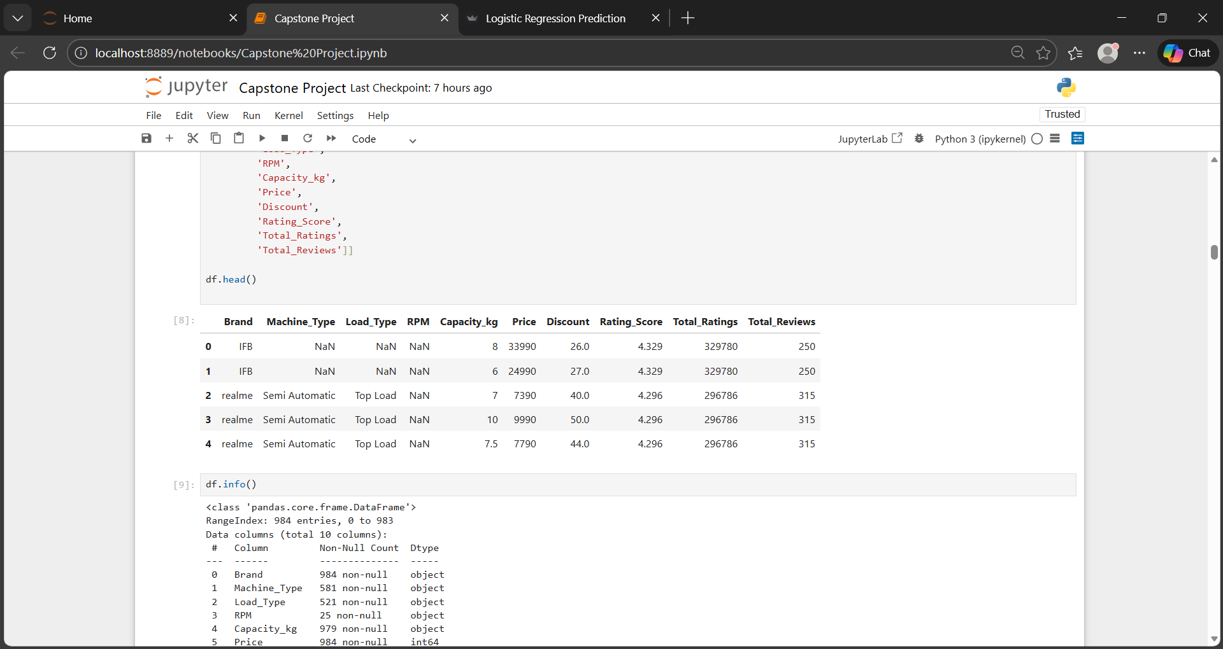
FEATURE EXTRACTION
Relevant product attributes were extracted from the raw Flipkart data using regular expressions (regex) to parse and clean unstructured text.This process ensured accurate and consistent data for analysis.
Key features :
  Brand
  Capacity_kg
  Load type
  Machine type
  RPM
  Price
  Discount
  Total_Ratings
  Total_Reviews

Slide 6
DATA CLEANING & PREPROCESSING
  Missing values were identified and handled to ensure dataset completeness.
  Outliers in numerical features, such as price and capacity, were analyzed and treated.
  Categorical variables, like load type and machine type, were encoded using Label Encoding.
  Text data was cleaned using regex to remove unwanted characters and standardize formats.
  The dataset was scaled and normalized where required to prepare for machine learning models.

Slide 7
SQL CONNECTIVITY &
DATA STORAGE
  Cleaned and processed data was stored in a SQL database using MySQL Workbench.
  Python was connected to the SQL database using appropriate database connectors.
  Processed data was pushed into SQL tables for structured and secure storage.
  Required data was pulled from the SQL database into Python for analysis and model training.
  This integration enabled efficient data management, reusability, and scalability across the project pipeline.

Slide 8
EXPLORATORY DATA ANALYSIS
Outlier Detection : Premium models identified as high-value outliers. So no removal needed as they represent niche market segments.
Visualizations Used:
Univariate Analysis :
Price Distribution - Histplot
Distribution of Load Types - Countplot
Bivariate Analysis :
Rating vs Price Analysis - Scatterplot
Price by Machine Type - Boxplot
Multivariate Analysis :
Correlation Heatmap for all numerical features

Slide 9
UNSUPERVISED MACHINE LEARNING
K-MEANS CLUSTERING
Objective :
  To identify natural groupings of washing machines based on their key features without pre-defined labels.
Approach :
  Selected relevant numeric features such as Price, Capacity, and RPM.
  Standardized data to ensure all features contribute equally.
  Applied K-Means Clustering to group similar washing machines.
  Determined the optimal number of clusters using Elbow Method and Silhouette Score.
Results :
  Cluster 1 – Economy: Affordable machines with basic functionality.
  Cluster 2 – Standard: Mid-range machines with balanced features.
  Cluster 3 – Premium: High-end machines with advanced features targeting niche buyers.
Visualization :
  Color-coded cluster chart for easy comparison of machine groups.

Slide 10
SUPERVISED MACHINE LEARNING
Objective :
  Predict the cluster (Economy, Standard, Premium) for a washing machine based on its features.
Approach :
  Used K-Means cluster labels as target labels.
  Features: Price, Capacity, RPM, Load Type, etc.
  Applied Logistic Regression, KNN, SVM, Random Forest, and XGBoost.
  Performed hyperparameter tuning to optimize performance.
Results :
  High accuracy achieved across models.
  Best-performing model selected for deployment.
  Enables automatic prediction of cluster for new washing machines.
Visualization :
  Accuracy comparison chart or confusion matrix for model performance.

Slide 11
HYPERPARAMETER TUNING
Objective :
  Improve model performance by optimizing model parameters.
Approach :
  Applied tuning techniques on supervised models.
  Used GridSearchCV for parameter optimization.
  Evaluated models using accuracy.
Models Tuned :
  Logistic Regression
  K-Nearest Neighbors (KNN)
  Support Vector Machine (SVM)
  Random Forest
  XGBoost
Outcome :
  Improved or stabilized model performance.
  Selected the best-performing model for deployment.

Slide 12
MODEL DEPLOYMENT
Objective :
  Deploy the best-performing model to predict washing machine clusters in real time.
Approach :
  Selected the best model based on accuracy and stability.
  Saved trained model and preprocessing objects using joblib.
  Built an interactive web application using Streamlit.
Application Features :
  User inputs washing machine features (Price, Capacity, RPM, Load Type, Machine Type, etc.).
  Model predicts the appropriate cluster (Economy, Standard, Premium).
  Simple and user-friendly interface for easy interaction.
Outcome :
  Enables real-time predictions.
  Makes the machine learning solution accessible to end users.

Slide 13
PROJECT INSIGHTS
  Washing machines form well-defined clusters based on price and feature combinations.
  Price, capacity, and RPM were the most influential features in cluster formation.
  The clustered data showed strong linear separability, favoring simpler models.
  Logistic Regression outperformed other models, delivering the highest and most consistent accuracy.
  Hyperparameter tuning improved model stability rather than accuracy, confirming robust feature engineering.
  The final model choice balanced performance, interpretability, and deployment efficiency.

Slide 14
DEPLOYMENT INSIGHTS
  The deployed Logistic Regression model accurately classifies all three clusters (Economy, Standard, Premium) based on user inputs.
  Price, capacity, and RPM changes clearly shift predictions, showing the model has learned meaningful feature relationships.
  Mid-range inputs are correctly predicted as Standard, validating smooth decision boundaries between clusters.
  Extreme values (high-end or low-end) are consistently mapped to Premium and Economy, proving robustness.
  The Streamlit application successfully enables real-time, end-to-end prediction, confirming the model is production-ready.

Slide 15
RECOMMENDATIONS
  Use the deployed Logistic Regression model for real-time washing machine classification due to its accuracy and reliability.
  Leverage predicted clusters to support pricing, product positioning, and inventory decisions.
  Integrate the application with live e-commerce data to enable automatic classification of new products.
  Monitor predictions over time and retrain the model periodically with updated market data.
  Extend the solution to include customer preference or sales analysis for deeper business insights.

Slide 16
CONCLUSION
  The project successfully implemented an end-to-end machine learning pipeline from data collection to deployment.
  K-Means clustering effectively segmented washing machines into meaningful market groups.
  Logistic Regression emerged as the best-performing model, delivering high accuracy and consistent predictions.
  The trained model was successfully deployed using Streamlit for real-time classification.
  The solution demonstrates a scalable and practical approach to product segmentation and prediction.

Slide 17
THANK YOU

